Slide 1
Capstone Project - The Neighborhoods of Paris - Restaurants

Slide 2
Where to open a new restaurant in Paris
Background
Paris is the capital and most popular city in France
Paris is currently ranked 3rd in the global economic power index
Target Audience
Business people who would like to invest or open a restaurant
Workers or students who prefer to find the close restaurant
Data Scientists who want to implement different analysis based on the datasets and information provided

Slide 3
Data acquisition and cleaning
Scrapping the following Wikipedia page on https://en.wikipedia.org/wiki/Arrondissements_of_Paris
Get the coordinates of the Arrondissements using Geopy Library
Using the python folium library to get the map of 20 Arrondissements
Using the FourSquare Location Data

Slide 4
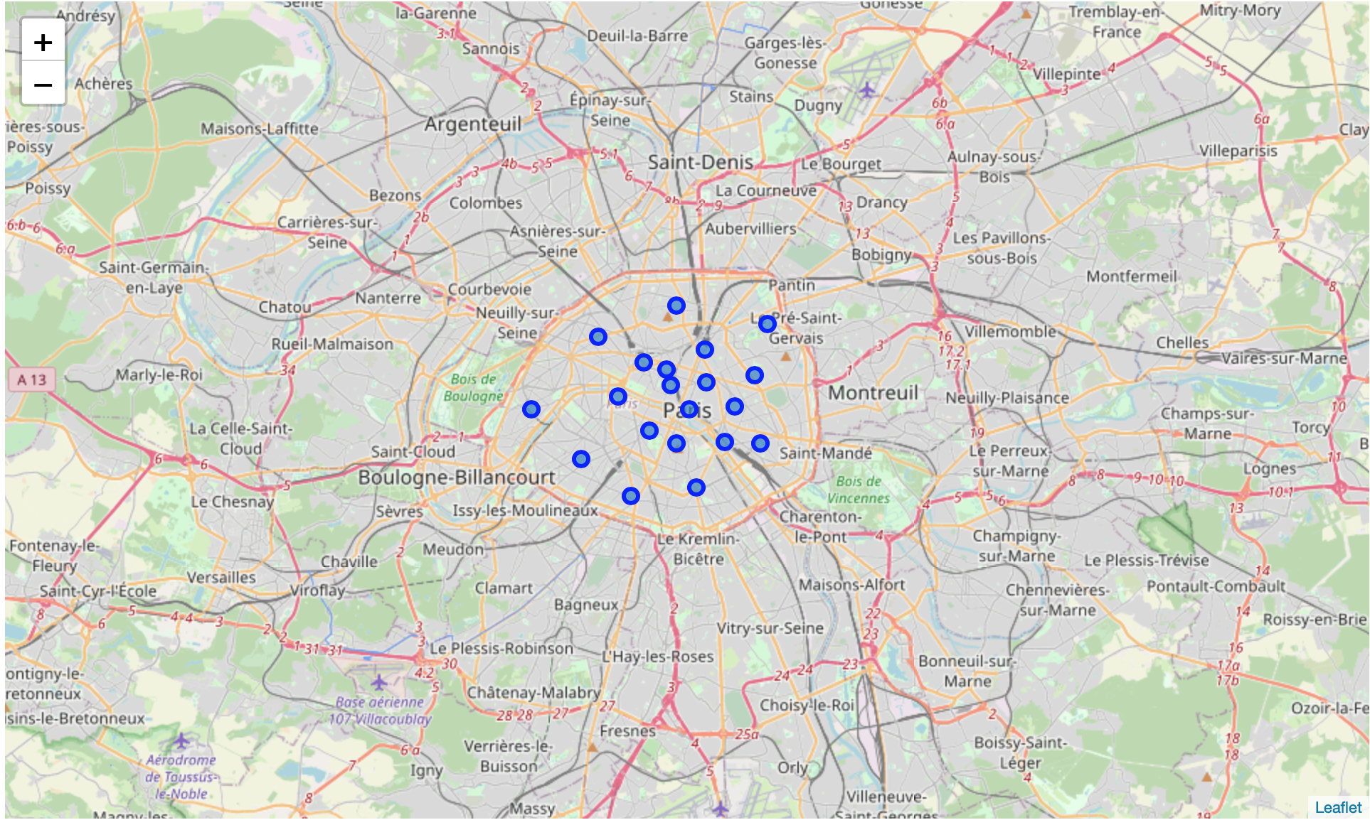
The map of Paris of 20 Arrondissements

Slide 5
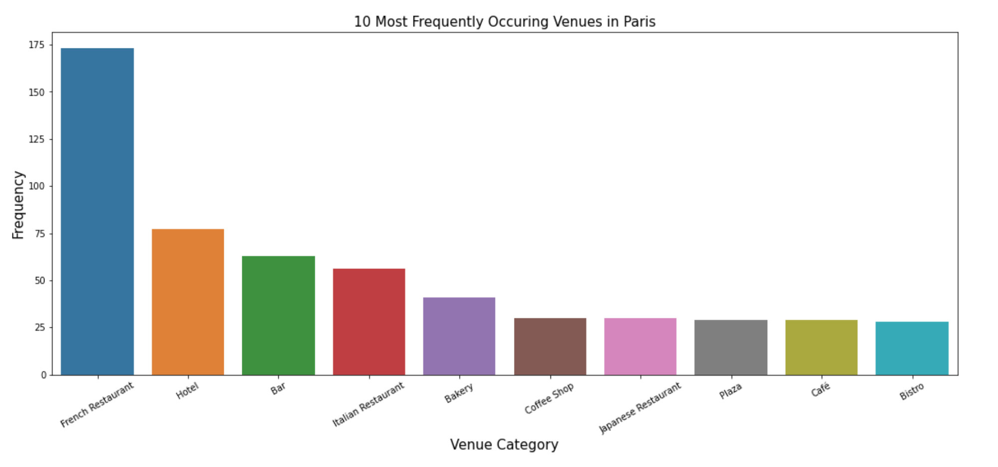
Explore the venue categories for Paris
French Restaurant top the chart below

Slide 6
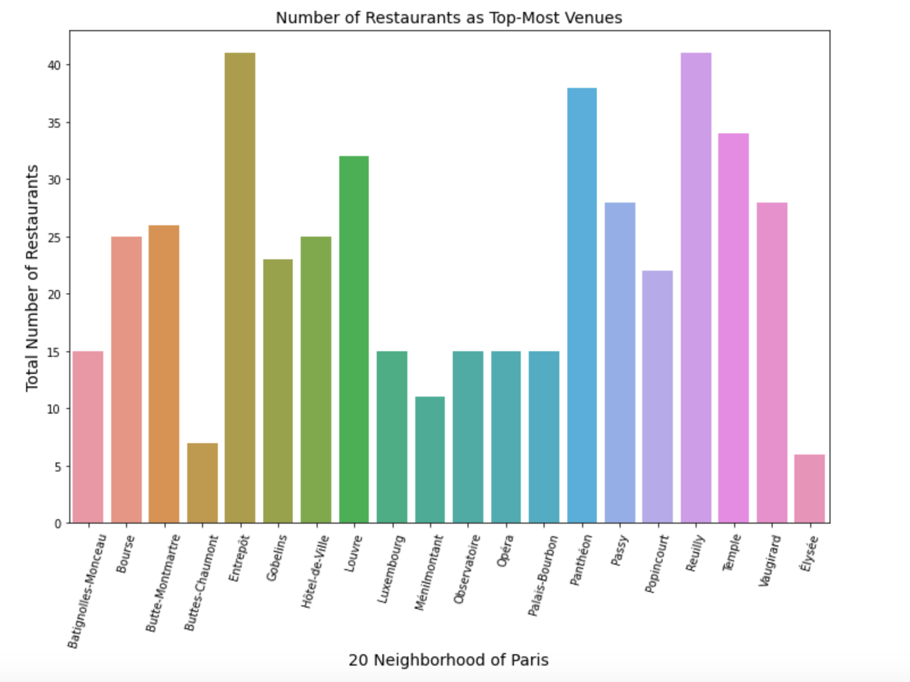
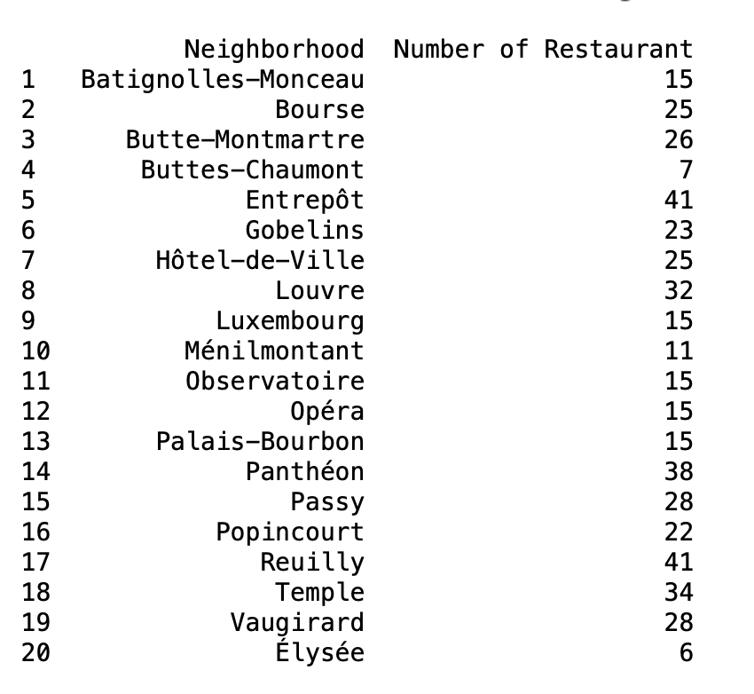
20 Neighborhood with total number of restaurants

Slide 7
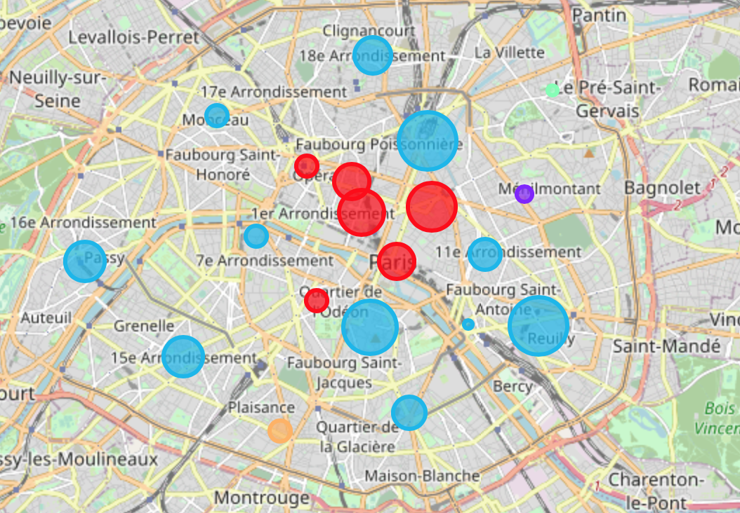
Clustering Neighborhoods in Paris
Blue and Red Clusters have higher competition for restaurants compared to other 3 clusters (Purple, Green and Yellow)

Slide 8
Results and Conclusion
According to the above charts, Menilmontant is a great place to open the French restaurant since the French restaurant only ranked 6th in the common venues there. Also the 1st and the 2nd Venue there are Bar and Pizza Place.
In addition, there are not many restaurants within the area, where only ranked 18th among the total 20 Arrondissements. In Pairs.
The data analysis might be improved by finding related land price data for each Arrondissement in Paris or neighborhood detailed information along with machine learning algorithm to get more statistical analysis for better suggestion and detailed results.

